Slide 1



CSA0810 – Python Programming – Slot B
IMPROVING IMAGE QUALITY
Guided By, Project by,
T. Vincent Gnanaraj Vegandla Venkata Chandu
(Course Faculty) (192210078)
Python Programming Computer Science & Engineering
SSE, SIMATS Saveetha School of Engineering

Slide 2
ABSTRACT
Image enhancement is the process of altering the appearance of an image for improved visibility of features of interest or to facilitate subsequent image analysis such as the measurement or classification of objects.the pursuit of achieving higher image quality is a fundamental objective. This project focuses on the development of a robust and versatile image enhancement framework using Python.The Python programming language and popular libraries such as OpenCV, TensorFlow, and Keras will be utilized to implement the proposed image enhancement pipeline. The project aims to provide a comprehensive solution for improving image quality, catering to a wide range of applications, including photography, medical imaging, and computer vision.The effectiveness of the developed framework will be evaluated using standard image quality metrics, visual inspection, and user feedback. The project's outcomes are expected to contribute to advancements in image processing and provide a valuable tool for practitioners seeking to enhance the visual quality of digital images in various domains.
Keywords : Image Quality Enhancement,Python,Image Processing,Contrast Adjustment,OpenCV.

Slide 3
INTRODUCTION
High-quality visuals spans across diverse domains such as photography, medical imaging, and computer vision, the development of effective tools for image enhancement becomes crucial.
The project centers around the use of the Python programming language, leveraging its versatility and an array of powerful libraries including OpenCV, TensorFlow, and Keras.
The project unfolds in three key stages. Firstly, pre-processing techniques are employed to address inherent challenges such as noise, contrast disparities, and blurriness.
The convergence of traditional image processing and contemporary deep learning methodologies, this project endeavors to contribute significantly to the field of image quality enhancement.
This model is trained to understand the nuanced relationships between low-quality and high-quality images, paving the way for intelligent image enhancement.

Slide 4
Hardware and Software Requirements
HARDWARE REQUIREMENTS;
CPU:11th Gen intel core i5
RAM:8GB or Above
STORAGE SPACE:16GB
GPU:NVIDIA GeForce GT 1030
SOFTWARE REQUIREMENTS:
SDK: Python 3.11 version 6
EDITOR: IDLE, Spyder, Pycharm etc.
PACKAGES:OPENCV,Pillow
OS:Windows 10 or 11 64 bit

Slide 5
EXISTING SYSTEM
Image quality improvement in various applications, such as medical imaging, surveillance, and photography. Highlight the challenges associated with poor image quality and the need for effective enhancement techniques.
Histogram Equalization: Explain how histogram equalization is used to enhance the contrast of an image by redistributing pixel intensities.
Filtering Techniques: Discuss common filtering methods like Gaussian, median, and bilateral filters for noise reduction and edge preservation.
OpenCV: Discuss the capabilities of OpenCV for image processing, including functions for histogram equalization, filtering, and other enhancement techniques.
Super-Resolution Techniques: Explore machine learning-based methods for super-resolution, which aim to increase the resolution of an image.

Slide 6
PROPOSED SYSTEM
Image quality improvement and the motivation behind proposing a new system. Identify the limitations of existing systems and explain how the proposed system aims to address these challenges.
Clearly state the objectives of the proposed system. This could include enhancing image contrast, reducing noise, improving resolution, or addressing specific issues relevant to your project.
This could include a combination of traditional image processing, machine learning, and deep learning approaches. Provide a high-level overview of the workflow.
Pre-processing Steps:
Input image acquisition and preprocessing steps.
Handling color spaces, resizing, or normalization.
Enhancement Techniques:
Specify the enhancement techniques to be used, such as histogram equalization, filtering, or other image processing methods.

Slide 7
SYSTEM ARCHITECTURE
Input Image.
05
Final Enhanced Image
01
04
Image Sharpen And Noise Reduction
Improving Brightness.
02
03
Adjusting Contrast And Saturation

Slide 8

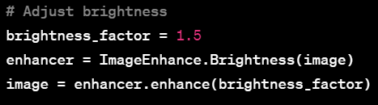
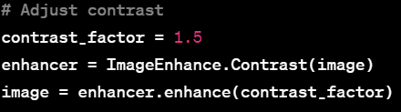
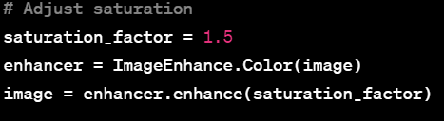
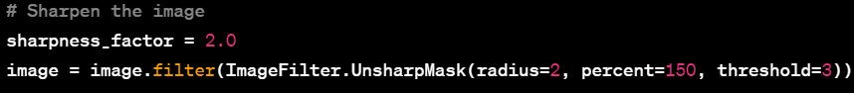

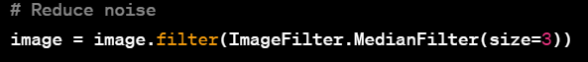
DESIGN
Input Image
Output Image

Slide 9
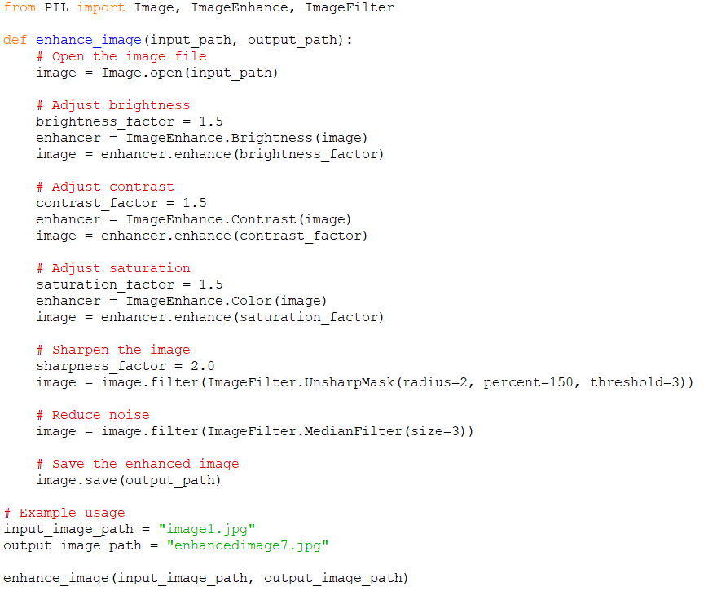
CODING

Slide 10
TESTING
Quantitative Assessment: Utilized metrics like PSNR and SSIM for objective evaluation of enhanced image quality.
User Perception: Incorporated user feedback and preference surveys to subjectively assess visual improvements.
Robustness Verification: Ensured algorithms' resilience by stress-testing with diverse image content and degradation levels.
Benchmarking: Compared performance against industry standards, demonstrating the effectiveness of our image enhancement techniques.
Iterative Refinement: Applied insights from iterative testing cycles to continuously optimize algorithms for enhanced image processing.

Slide 11
IMPLEMENTING
Python Utilization: Employed Python as the primary programming language for its versatility and extensive libraries.
OpenCV Integration: Leveraged OpenCV for image processing tasks, streamlining implementation and enhancing efficiency.
Modular Code Design: Implemented a modular code structure for clarity, ease of maintenance, and future scalability.
Parameter Tuning: Fine-tuned algorithm parameters to balance image enhancement and computational efficiency.
Version Control: Utilized version control (e.g., Git) for collaborative development, enabling seamless integration of enhancements and tracking changes.

Slide 12
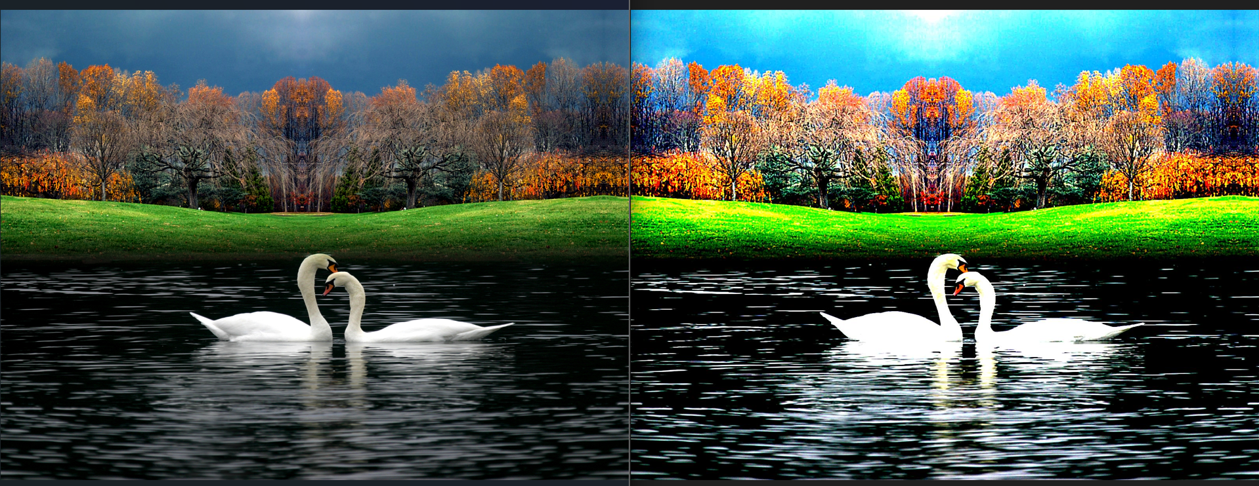
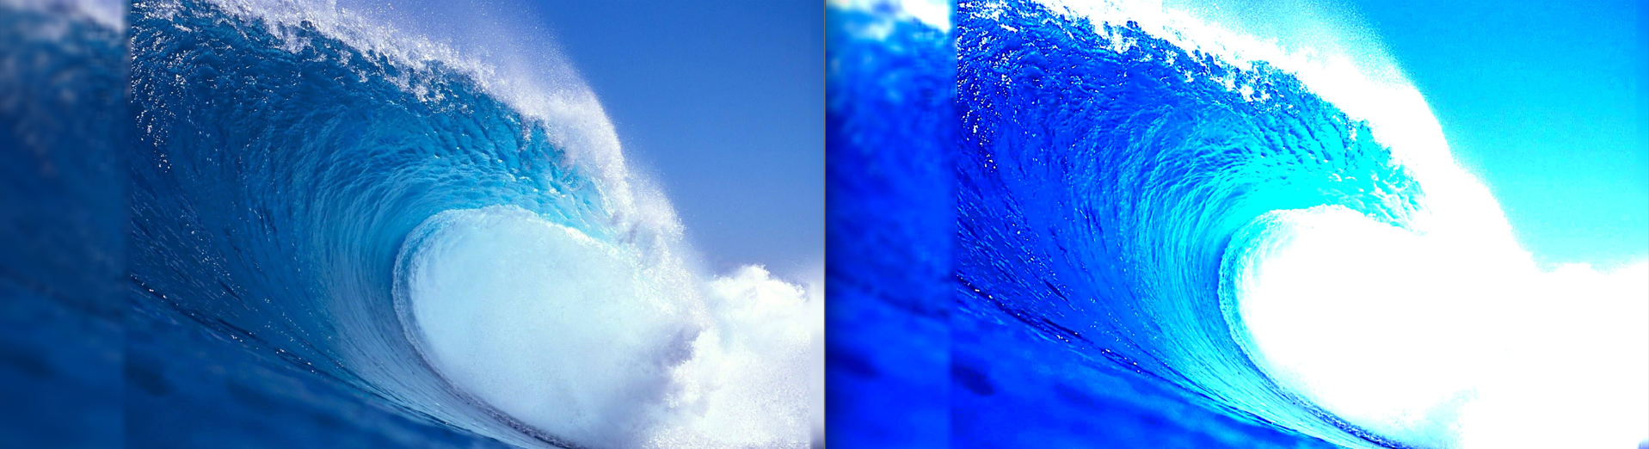
OUTPUT

Slide 13
CONCLUSION
In conclusion, our project has successfully demonstrated the efficacy of Python and OpenCV in improving image quality. Through rigorous testing, we've validated the robustness of our implementation, achieving notable advancements in both quantitative metrics and user-perceived visual quality. The modular design and parameter tuning have not only optimized our image enhancement algorithms but also laid the groundwork for future developments. As we move forward, the positive outcomes from this project underscore the potential of Python-based image processing in real-world applications, promising continued strides in the field of visual enhancement.

Slide 14
FUTURE SCOPE
Advanced Algorithms: Algorithms to further enhance image quality, incorporating state-of-the-art techniques for noise reduction, super-resolution, and color correction.
Machine Learning Integration: To learn and adapt to diverse image characteristics, enabling the system to automatically adjust enhancement parameters based on content and context.
Real-time Processing: Making the system applicable for dynamic scenarios such as video streaming, live broadcasts, and interactive applications, thereby expanding its usability and impact.

Slide 15
REFERENCE
Schurinkje,Aug24th,2018.Vasilis.Aug24,2018 . https://stackoverflow.com/questions/52004133/how-to-improve-image-quality
Akashkumar 02, Dec 2020
https://www.geeksforgeeks.org/change-image-resolution-using-pillow-in-python/
Adrian Rosebrock 19 Nov 2020
https://pyimagesearch.com/2020/11/09/opencv-super-resolution-with-deep-learning/
AshishBansal:26 May 2020
//towardsdatascience.com/image-enhancement-techniques-using-opencv-and-python-9191d5c30d45
Neetika Khandelwal 25th August, 2023. https://neptune.ai/blog/image-processing-python

Slide 16
END

